Slide 1
Post-HF methods: Perturbation Theory, Coupled-clusters, Complete active space, Zeeman splitting (EPR)
Instructor: Prof. Tzuhsiung (Nick) Yang
Email: tyang@mx.nthu.edu.tw
Time: M5/6
Room: NTHU Library Comp Lab II
Notes:
Rafael Gomez

Slide 2
Suggested readings
Cremer, D. Møller–Plesset Perturbation Theory: From Small Molecule Methods to Methods for Thousands of Atoms. WIREs Computational Molecular Science 2011, 1 (4), 509–530.
Bartlett, R. J.; Musiał, M. Coupled-Cluster Theory in Quantum Chemistry. Rev. Mod. Phys. 2007, 79 (1), 291–352.
Roos, B. O. The Complete Active Space Self-Consistent Field Method and Its Applications in Electronic Structure Calculations. In Advances in Chemical Physics; John Wiley & Sons, Ltd, 1987; pp 399–445.

Slide 3
Case study

Slide 4
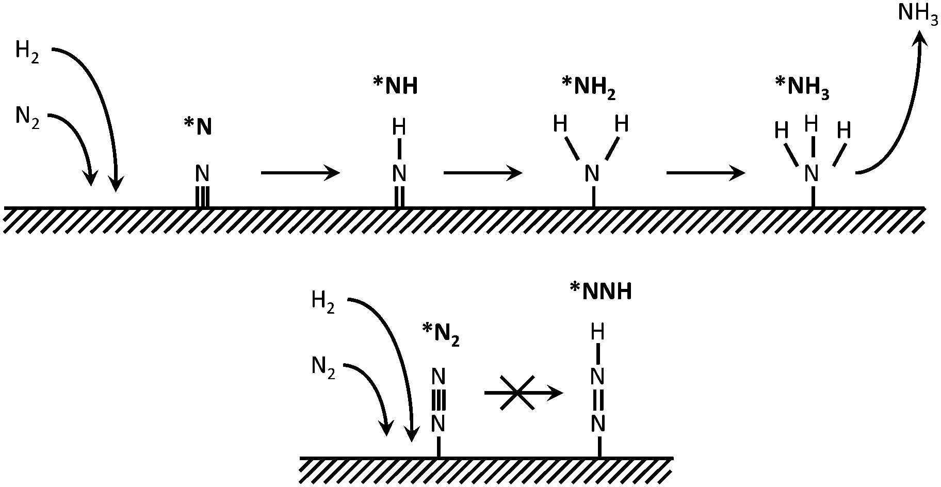
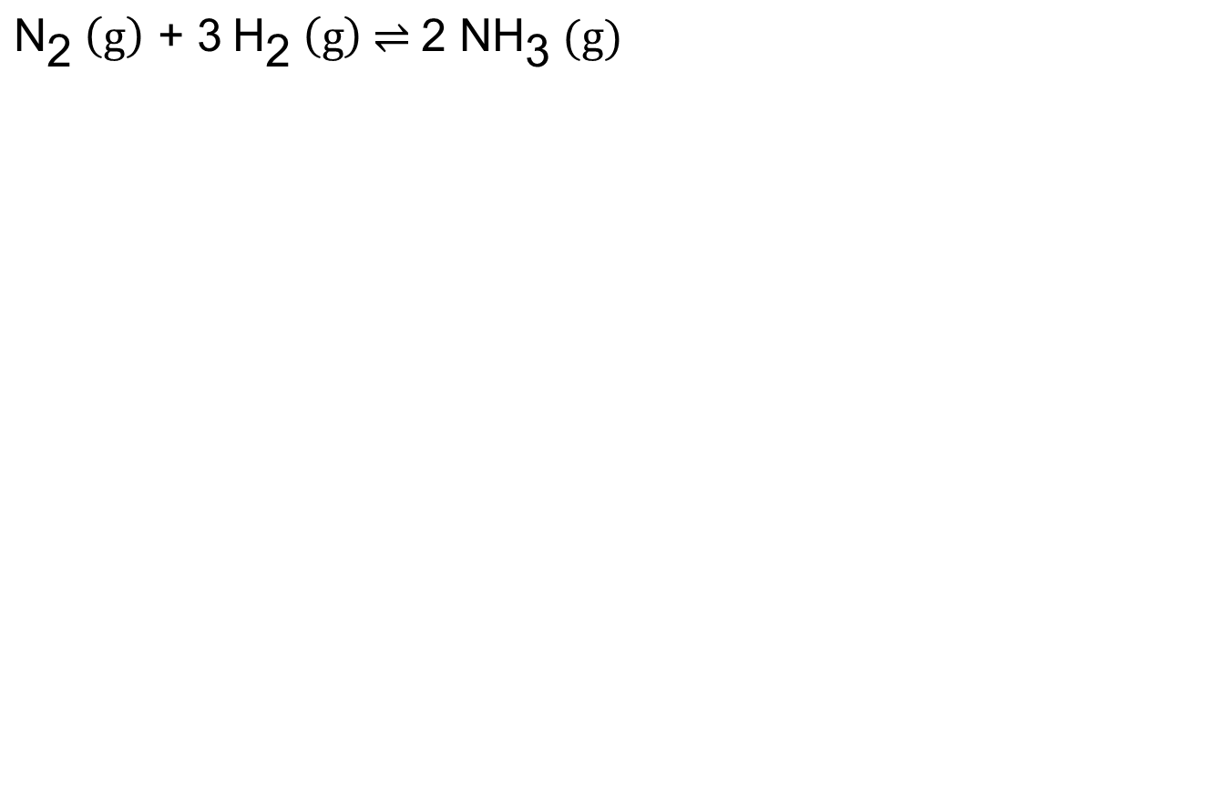
Haber-Bosch process
$${\text{N}}_{\text{2}} \left(\text{g}\right)\text{ + 3} {\text{H}}_{\text{2}} \left(\text{g}\right) \text{⇌} \text{2 }\text{N}{\text{H}}_{\text{3}}\text{ (}\text{g}\text{)}$$
Chem. Soc. Rev. 2014, 43, 5183

Slide 5
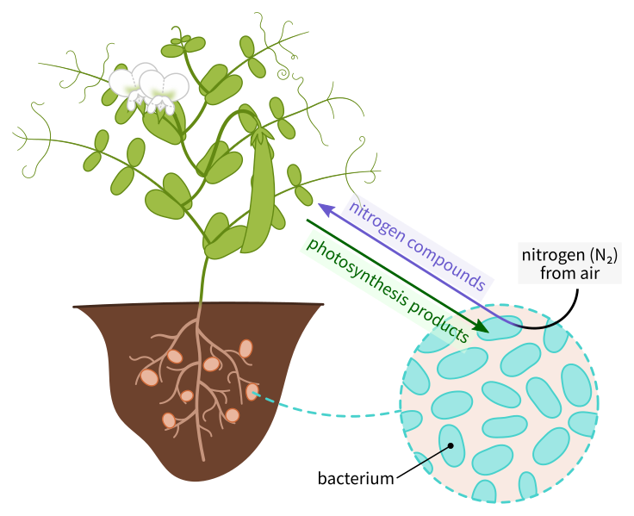
Nitrogen fixation
Symbiotic bacteria produces ammonia from atmospheric N₂ in exchange for the nutrients from their host plants

Slide 6
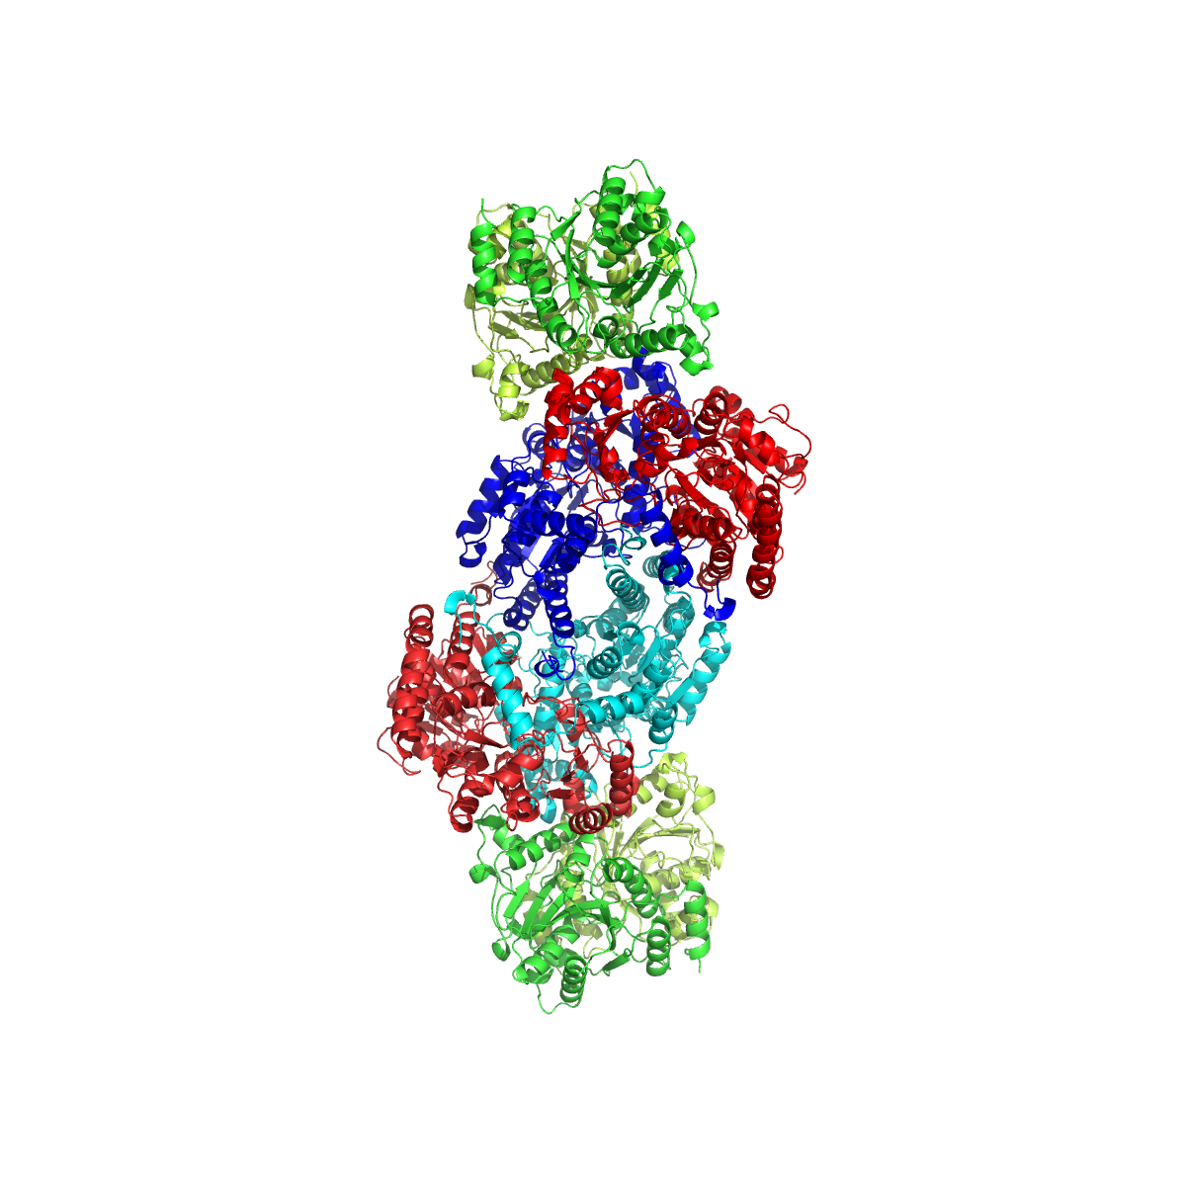
Nitrogenase
Nitrogenase

Slide 7
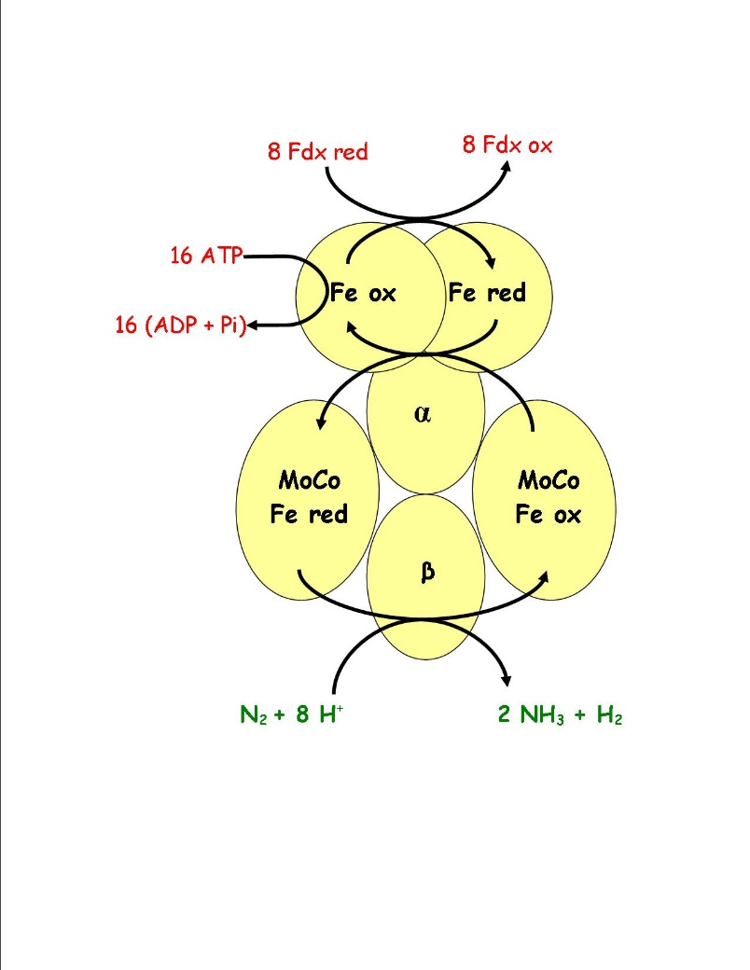
Nitrogenase
Nitrogenase

Slide 8
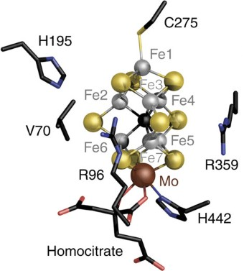
Nitrogenase
Nat. Commun. 2016, 7, 10902

Slide 9
Nitrogenase
Nat. Commun. 2016, 7, 10902

Slide 10
Nitrogenase
“C⁴⁻”
Science 2011, 334, 974

Slide 11
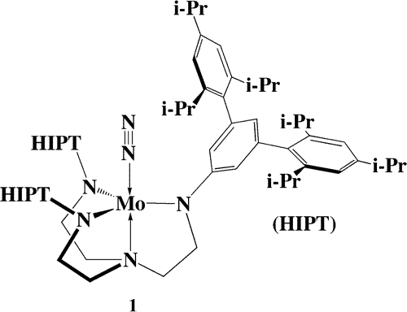
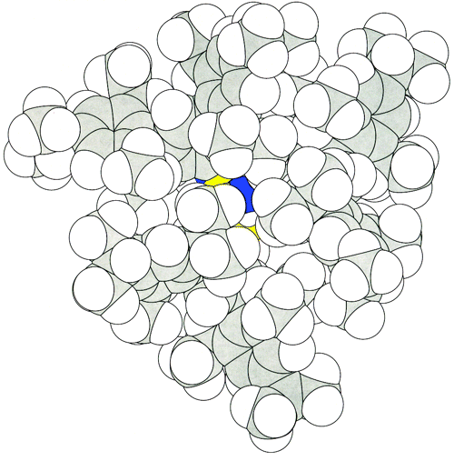
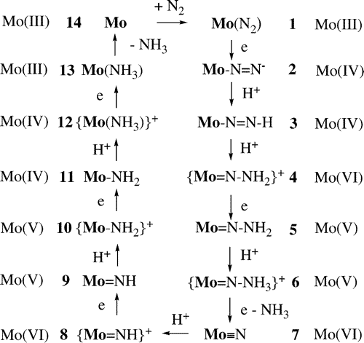
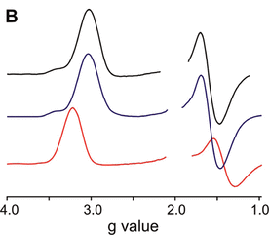
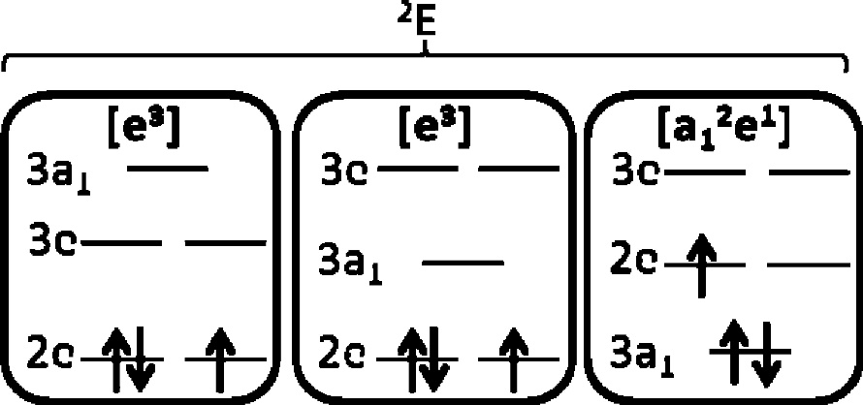
Model complex
(1) Schrock, R. R. Catalytic Reduction of Dinitrogen to Ammonia at a Single Molybdenum Center. Acc. Chem. Res. 2005, 38 (12), 955–962.
(2) Yandulov, D. V.; Schrock, R. R. Catalytic Reduction of Dinitrogen to Ammonia at a Single Molybdenum Center. Science 2003, 301 (5629), 76–78. (3) McNaughton, R. L.; Roemelt, M.; Chin, J. M.; Schrock, R. R.; Neese, F.; Hoffman, B. M. Experimental and Theoretical EPR Study of Jahn−Teller-Active [HIPTN3N]MoL Complexes (L = N2, CO, NH3). J. Am. Chem. Soc. 2010, 132 (25), 8645–8656.

Slide 12
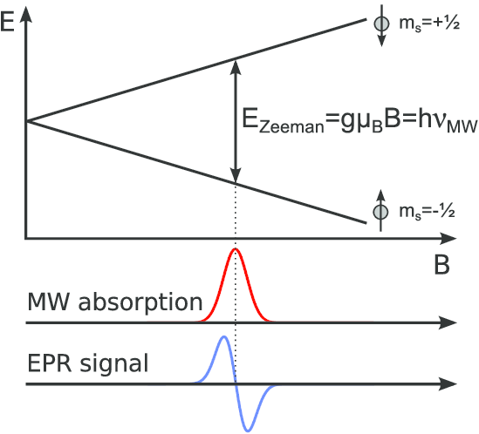
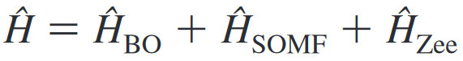
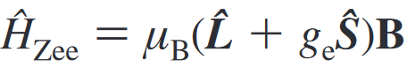
Zeeman splitting
Spinning charges (e.g. electron precession) generate local magnetic field, which interacts with external magnetic field.

Slide 13
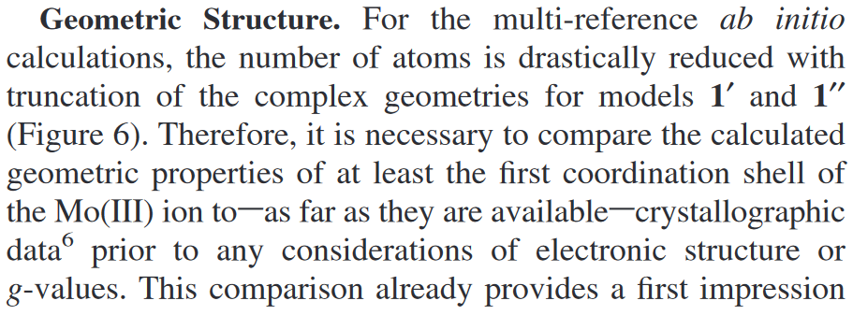
Interactive

Slide 14
Molecular visualizers
Molecular visualizers: Graphic user interfaces that allow you to visualize molecules by their coordinates
Avogadro
Jmol
Mercury
PyMOL
UCSF Chimera
Vesta
VMD

Slide 15
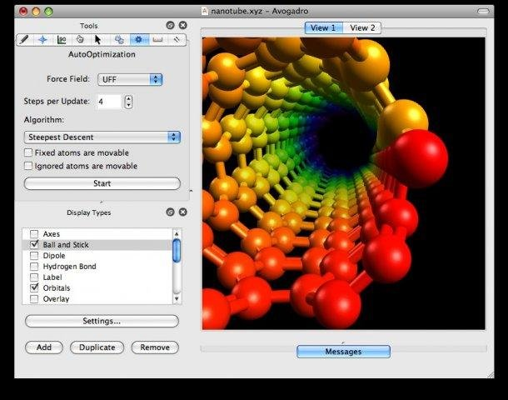

Avogadro
Avogadro is a molecular editor and visualizer with limited support for force field optimization. It is written as a GUI for the backend openbabel
Cross platform
Multiple language support

Slide 16

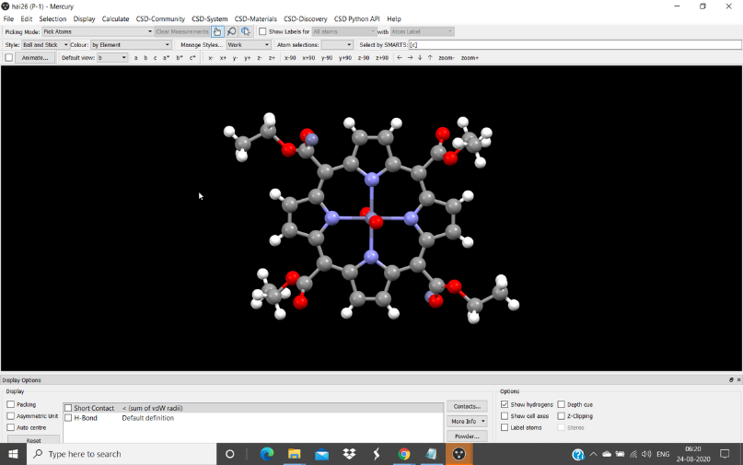

Mercury
Mercury is a molecular visualizer developed by the Cambridge Crystallographic Data Centre (CCDC)
It can be downloaded as a stand-alone software or as a part of the licensed CCDC software suite
It is specially designed to handle crystal structures
It has limited molecular building functionality

Slide 17
Interactive
Obtain the crystallographic information file (cif) for Mo-NH₃ complex from ref 6 of the paper using webcsd.
Remove the bulky R groups on the amide side arms, solvent molecules, and disorders from the cif file using Avogadro (tips: 1) under drawing mode, right click on bonds will replace the bonds with hydrogen caps; 2) under click mode, double click on an atom of a molecule will select the whole molecule; 3) click delete on your keyword will delete the selected atom(s))
Go to build > Cartesian Builder and copy the coordinates of the modified molecule (30 atoms).

Slide 18
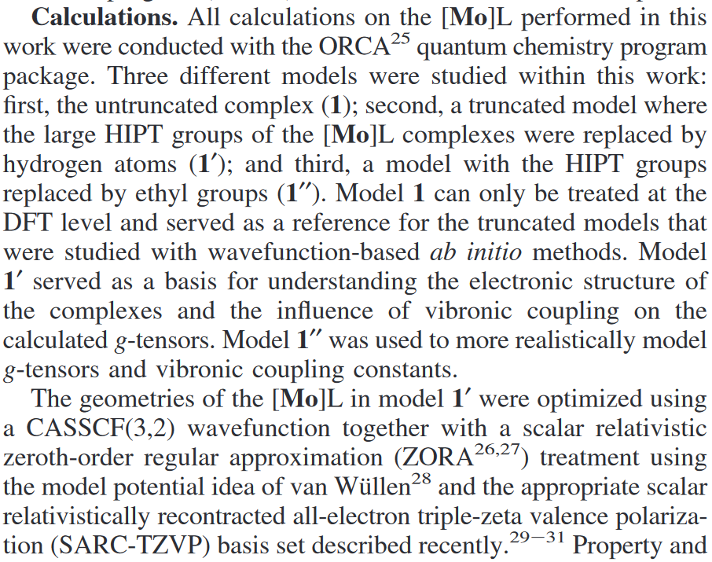
Interactive

Slide 19
Interactive
Paste the coordinates to “Mo-TAEA-NH3.xyz” in Exercise1.
Submit the optimization job.
Read the input file. What do you see that is different from those before?

Slide 20
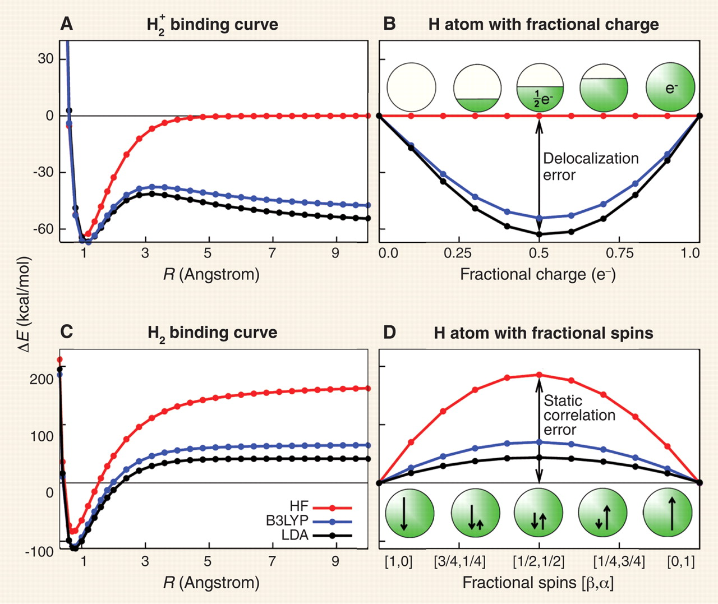
Errors in DFT
Cohen, A. J.; Mori-Sánchez, P.; Yang, W. Insights into Current Limitations of Density Functional Theory. Science 2008, 321 (5890), 792–794.

Slide 21
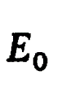
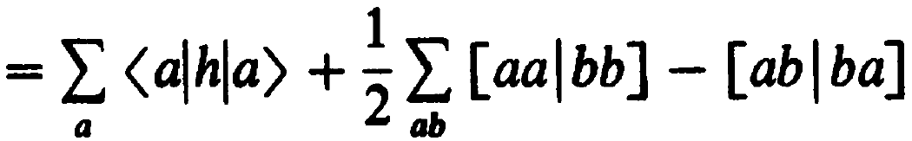
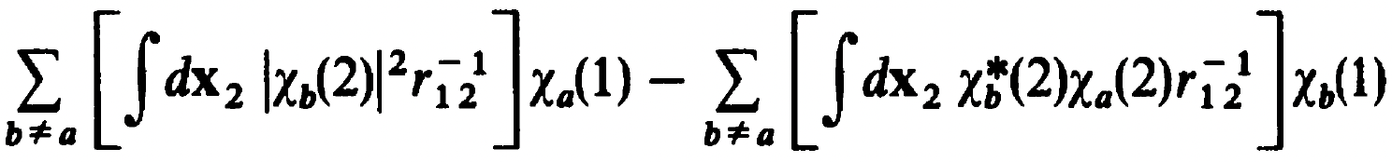
Fock operator
In order for the Hamiltonian to act on N-electrons within a mean-field, the two-electron integrals are replaced with mean-field integrals (operators).
$$⇒$$
$$⇒$$
The first term ${\hat{J}}_{b}\left(1\right)$ is a local operator that describes the total averaged potential acting on $χ_{a}(1)$.
The second term ${\hat{K}}_{b}\left(1\right)$ is a non-local operator that describes the total averaged potential, formed by other electrons if they were smeared in the space of $χ_{b}^{∗}χ_{a}$, acting on electron one if it was in spin orbital $χ_{b}$.

Slide 22
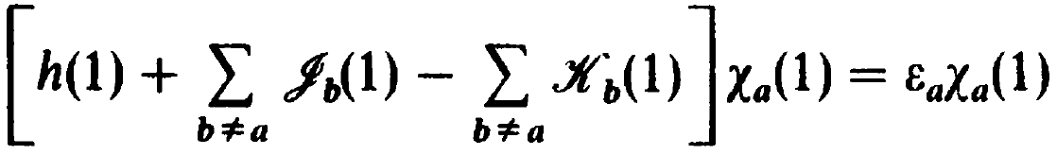
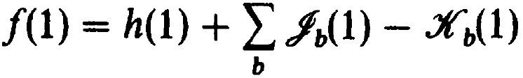
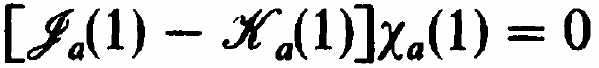
Fock operator
With the mean-field approximation, we can write down the (pseudo)eigenvalue problem which gives orbital energies
The operator (Fock operator) can be further written as
because
This last equation that the coulomb and exchange interactions cancel each other out exactly at the one-electron limit may seem trivial. However, it is a very important physical constraint and it is one of the main errors in density functional theory (DFT) called self-interaction error.

Slide 23
Interactive
UHF
J_{11,a} is 0.77 Eh
K_{11,a} is 0.77 Eh
Self-interaction error is J_{11,a} - K_{11,a} = 0.000 Eh
UKS(PBE)
J_{11,a} is 0.3873 Eh
E_{xc} is -0.3851 Eh
Self-interaction error is J - E_{xc} = 0.0022 Eh

Slide 24
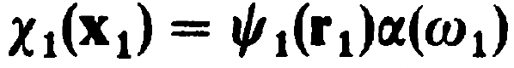
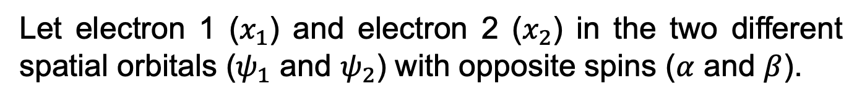
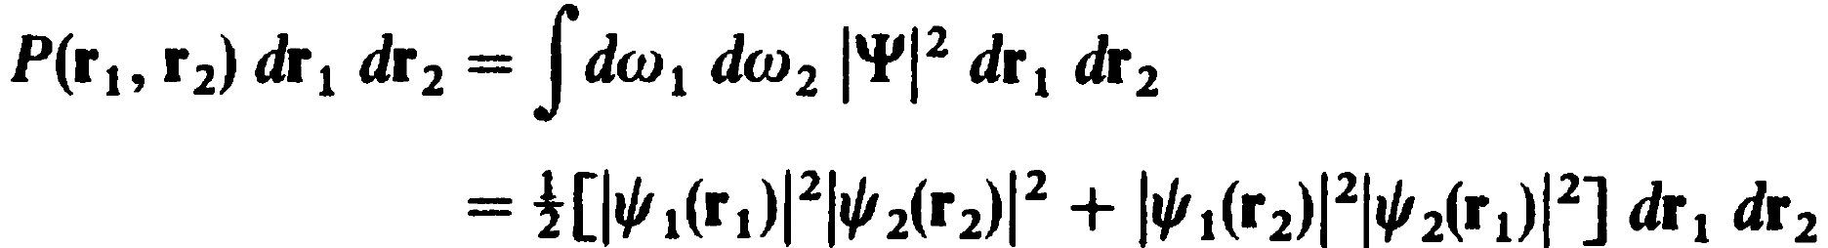
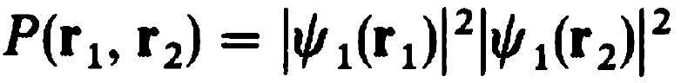
Slater determinants
Slater determinants still have the issue
Electrons with opposite spins are still not correlated
Let electron 1 ($x_{1}$) and electron 2 ($x_{2}$) in the two different spatial orbitals ($ψ_{1}$ and $ψ_{2}$) with opposite spins ($α$ and $β$).
,
The probability is
Cross terms vanish as $\left\langle α(w_{i}) | β(w_{i})\right\rangle =0$
Let $ψ_{1}=ψ_{2}$
$⇒$ there is finite probability of finding two electrons in the same spot, which is not physical, due to the lack of electron correlations for opposite spins.

Slide 25
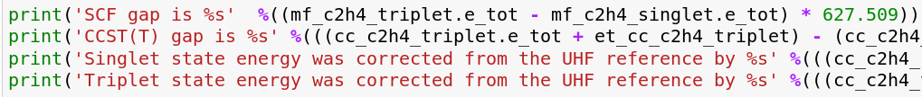
Interactive
SCF gap is 76.36
CCST(T) gap is 104.14
Singlet state energy was corrected from the UHF reference by -201.03
Triplet state energy was corrected from the UHF reference by -173.25

Slide 26
Errors in DFT
Cohen, A. J.; Mori-Sánchez, P.; Yang, W. Insights into Current Limitations of Density Functional Theory. Science 2008, 321 (5890), 792–794.

Slide 27
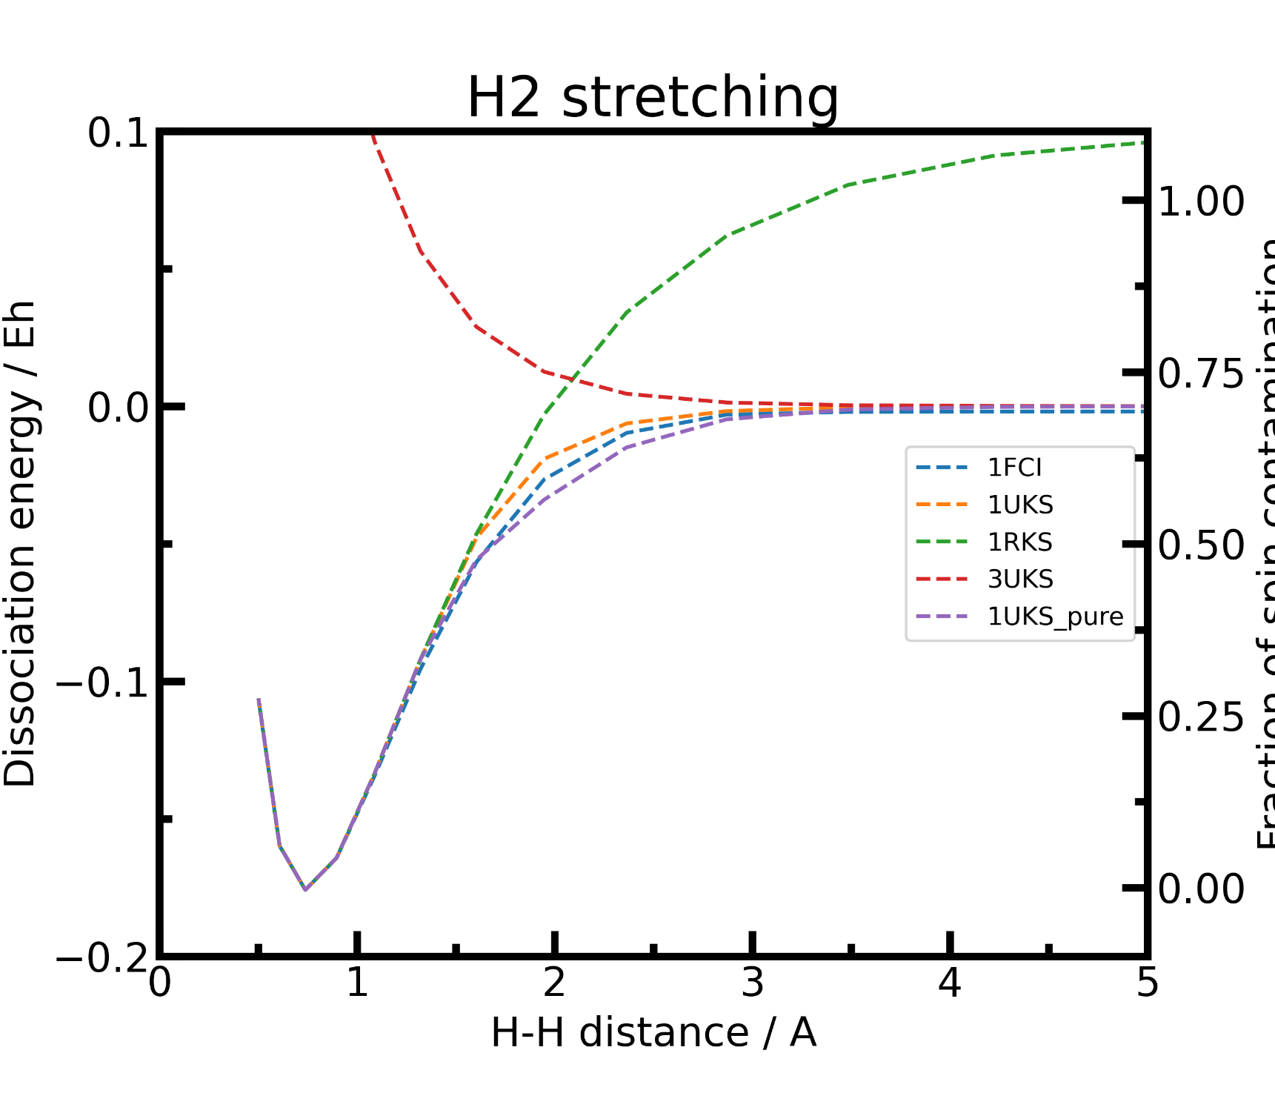

Slide 28
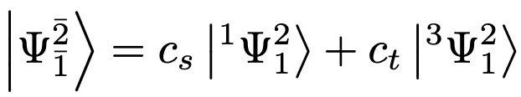
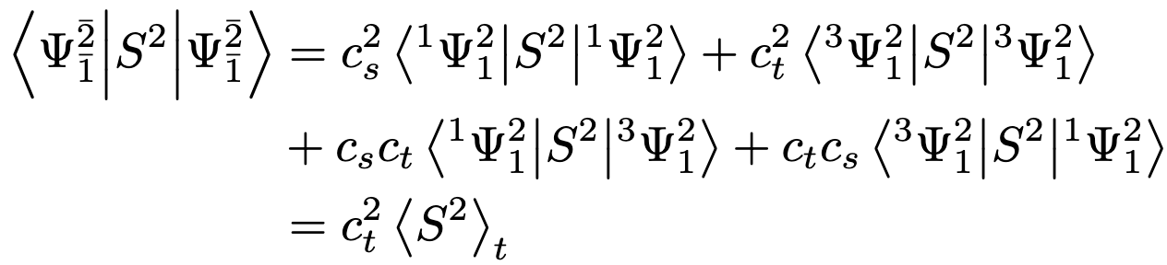
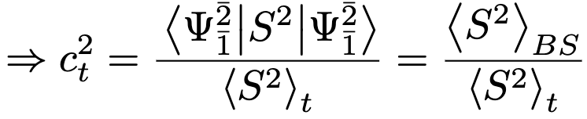
Broken symmetry state
The single determinant broken symmetry (BS) state can be written as a linear combination of the two SACs
The S² expectation value of the BS wavefunction is
Yamaguchi, K.; Jensen, F.; Dorigo, A.; Houk, K. N. A Spin Correction Procedure for Unrestricted Hartree-Fock and Møller-Plesset Wavefunctions for Singlet Diradicals and Polyradicals. Chemical Physics Letters 1988, 149 (5), 537–542.

Slide 29
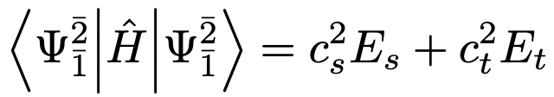
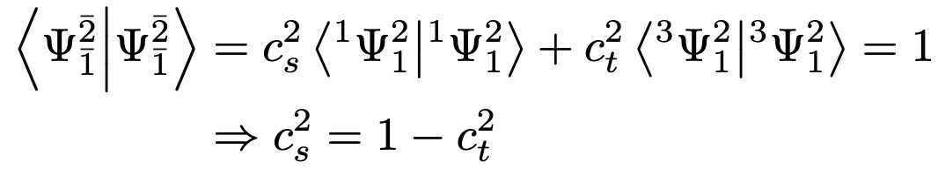
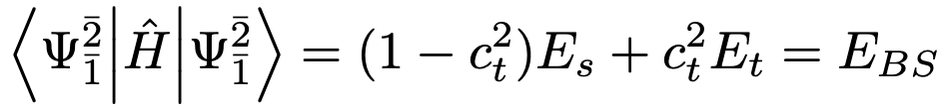
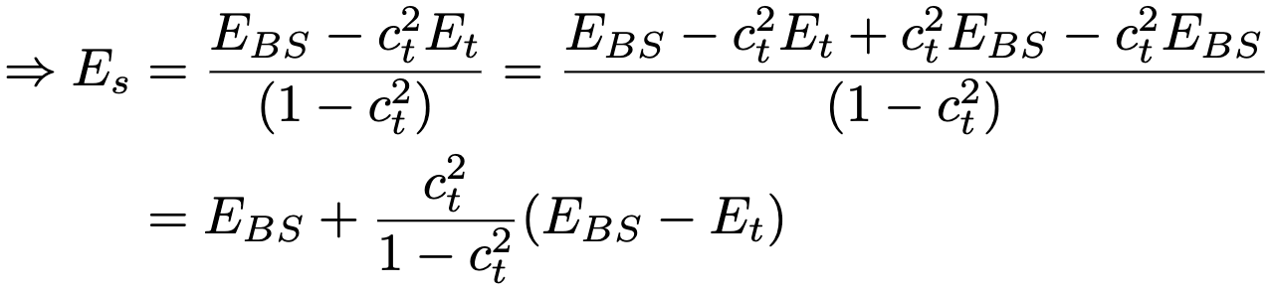
Broken symmetry state
The energy of the BS state
By orthonormality relation,
Hence, the energy of the BS and pure state
Yamaguchi, K.; Jensen, F.; Dorigo, A.; Houk, K. N. A Spin Correction Procedure for Unrestricted Hartree-Fock and Møller-Plesset Wavefunctions for Singlet Diradicals and Polyradicals. Chemical Physics Letters 1988, 149 (5), 537–542.

Slide 30
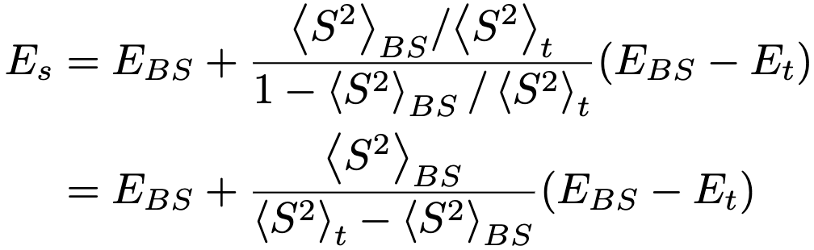
Spin purification
Substitute $c_{t}^{2}$ by the S² expectation values
$E_{t}$ can be obtained from any of the triplet wavefunctions
This process of correcting the energy of the BS state using the S² value of the BS and triplet states and the energy of the triplet state is called spin purification.
Yamaguchi, K.; Jensen, F.; Dorigo, A.; Houk, K. N. A Spin Correction Procedure for Unrestricted Hartree-Fock and Møller-Plesset Wavefunctions for Singlet Diradicals and Polyradicals. Chemical Physics Letters 1988, 149 (5), 537–542.

Slide 31
DFA vs HF
DFA:
Black box approximate functionals that may or may not be constrained to physics-based asymptotic limits.
Some have issues with SIE.
Have issues with static correlation.
HF
Formally exact within the mean field approximation.
No issue with one particle SIE.
Have issues with static correlation.
Have issues with dynamics correlation.

Slide 32
Post HF method
Given the advantages of HF theory, it is tempting to improve upon HF wavefunction. There are several ways to achieve such improvements:
For dynamic correlation:
Perturbation theory (PT).
Some examples are second order (MP2), third order (MP3), and fourth order (MP4) PT with their corresponding scaling N⁵, N⁶, and N⁷, respectively.
Coupled cluster (CC) theory
Some examples are CC singles and doubles (CCSD), and CCSD and triplets (CCSDT), and CCSD with perturbative triples (CCSD(T)) with their corresponding scaling N⁶, N⁸, and N⁷, respectively.

Slide 33
Post HF method
For static correlation:
Complete active space SCF (CASSCF), which scales as M*N⁴ where M is the number of configurations.
For both correlations:
CASPT2, which scales as M*N⁵.
N-electron valence second order perturbation theory (NEVPT2), which scales as M*N⁵.
Density matrix renormalization group (DMRG) CASSCF.

Slide 34
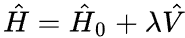
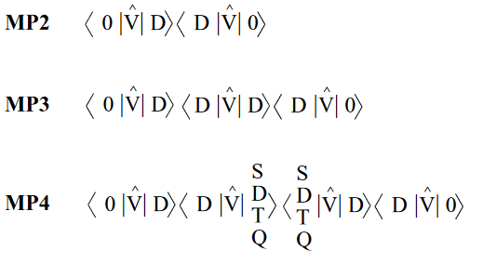
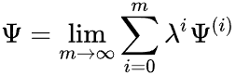
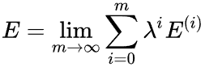
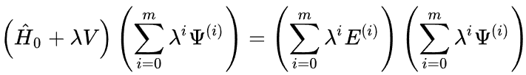
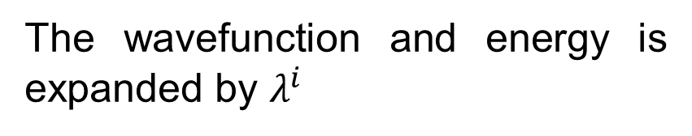
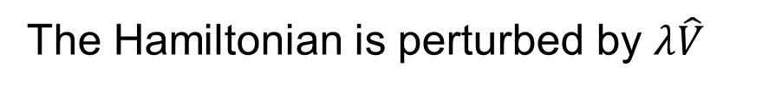
MP theory
Moller Plesset (MP), or many body (MB), perturbation theory is commonly employed post-HF method to treat dynamic correlation (the probability of finding two electrons in the same spot for opposite spins).
The Hamiltonian is perturbed by $λ\hat{V}$
The wavefunction and energy is expanded by $λ^{i}$
,
The Schrodinger equation is then

Slide 35
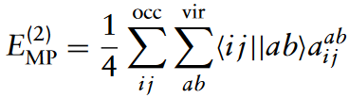
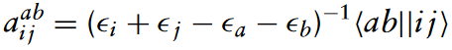
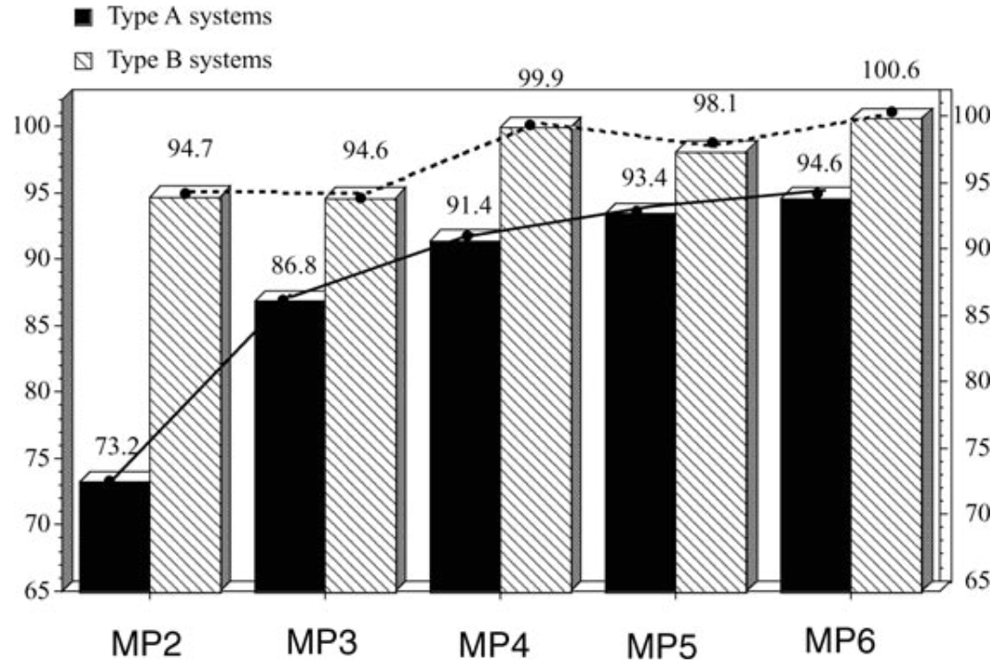
MP theory
At the second order, MP2, the correct has the form
,
Slow convergence of correlation energy

Slide 36
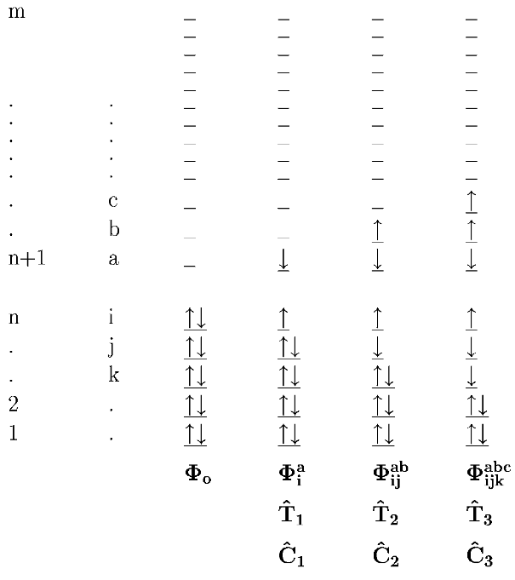



CC theory
Coupled cluster (CC) theory is commonly considered the best method among post-HF methods to treat dynamic correlation (the probability of finding two electrons in the same spot for opposite spins).
The CC wavefunction is
where the exponential of the excitation operator $\hat{T}$ can expressed using Taylor series expansion
and the excitation operator includes all orders of excitations

Slide 37


CCSD and CCSD(T)
Coupled clusters singles and doubles with perturbative triplets (CCSD(T)) is considered the golden standard of wavefunction theory (WFT) for quantum chemistry except for strongly correlated systems. At infinite order, MBPT and CC converge to the same expression.
Its performance is shown below
Reaction enthalpy

Slide 38
Interactive
Go to Exercise2 and run the codes.

Slide 39




CASSCF
Complete active space self-consistent field (CASSCF) method is one of the most commonly used post-HF method to treat multiconfiguration wavefunctions and explicitly treat static correlation.
The CAS wavefunction is
Each $\left|\left.μ\right\rangle \right.$ is called a configuration state function (CSF). The coefficients $C_{μ}^{\left(0\right)}$ are determined self consistently.
For a given N number of electrons, n number of active orbitals, and a total spin of S. There are N_{cas} CSFs.

Slide 40
CASSCF
One might have noticed that, unlike CCSD and MP2, CASSCF requires the user to specify an “active space” of M electrons and n orbitals. Indeed, the choice of the active space is largely driven by experience and chemical knowledge, rendering this method laborious. There are ongoing developments that focus on automating CAS selection by Reiher’s and Gagliardi’s groups.

Slide 41


Interactive
The MO diagram that focuses on the metal-ligand interactions have been reported by the paper:
We need to ensure that our active space includes either the two d orbitals that strongly correlate or the 5 d orbitals. This can be done via orbital rotation.

Slide 42


Interactive
However, recall that we used unrestricted determinants to reach a lower energy solution and mitigate the issue of static correlation (RHF overestimates H₂ dissociation energy while UHF recovers it). There is no guarantee that $ψ_{i,α}≈ψ_{i,β}$. This becomes an issue when we try to rotate a spin-orbital because the resulted $α/β$ pair might not be similar orbitals anymore.

Slide 43

Interactive
To solve this issue, we can use “unrestricted natural orbitals” (UNOs), which are formed by taking linear combinations of the self-consistent MOs to produce $α$ and $β$ MOs that have the same coefficients for each $i$. This procedure sacrifices that discrete occupation of the orbitals.
Go back to Exercise1 and run the UHF single point calculation. Wait for the calculation to finish then analyze the .uno file (which stores the coefficients for UNOs), i.e. plot out the UNOs that are around HOMO/LUMO and have large coefficients for Mo d AOs.

Slide 44

Interactive
Now, we have observed the UNOs, we can “rotate” the orbitals such that the 5 frontier orbitals look like those reported in the paper (have highest AO coefficients for MO d AOs). Submit rot.sub once you have decided which orbitals to swap. After the rotation job is complete (should be fast), submit epr.sub
The orbital to rotate out
The orbital to rotate in
The angle of rotation

Slide 45
Interactive
While the epr jobs are running, go to Exercise3. We will see how the choice of active space affects the energy.

Slide 46
CASPT2 and NEVPT2
As you can see from Exercise3, CASSCF energy converges quite slowly even for the simplest case of H₂ dissociation. This is because that the inactive and virtual spaces are not optimized; they are HF-like. The natural progress will be performing a MBPT or CC on top of a CASSCF wavefunction. Indeed, this is the idea behind CASPT2 and N-electron valence second order perturbation theory (NEVPT2)

Slide 47
Interactive
In Exercise4, we will look at how PT2 will help improve the energy for CAS reference wavefunction.

Slide 48

Interactive
At this point, you might start to wonder why we bother with CASPT2/NEVPT2 if CCSD(T) just outperforms them and is much easier to run. This impression roots from the choice of the model system, H₂ dissociation, which is not very strongly correlated. Now, we will look at one of the most famous strongly correlated molecular system, N₂ dissociation in Exercise5.

Slide 49

Interactive

Slide 50

Final caveat
Dans, P. D.; Walther, J.; Gómez, H.; Orozco, M. Multiscale Simulation of DNA. Current Opinion in Structural Biology 2016, 37, 29–45.

